Slide 1
SNAKE GAME PROJECT
CS 150-01
Dr. Sayani Sarkar
December 12th, 2023
Juan Ballas Marchant

Slide 2
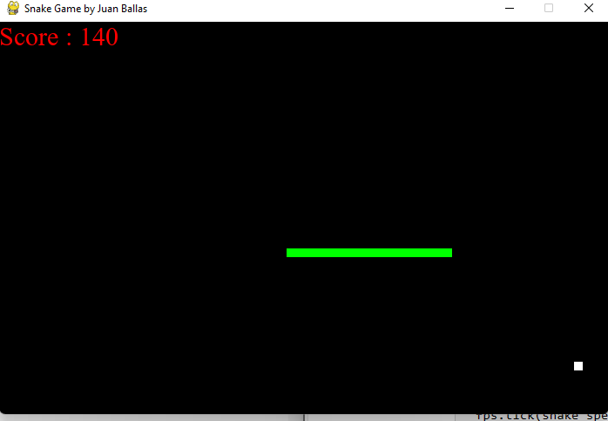
Introduction
The classic snake game
Entertainment

Slide 3
Project Overview
Python game
The objective of the project is to entertain the user.
Snake: moves, grows, crashes
Features and Functions:
Pygame, Time, Random
Init
Def
While, For, If,

Slide 4
Technical Details
Define the base of the game: window, color, speed, snake, fruit.
Create the variables to then apply them conditions
Snake functions: movement, if statements (grow, crash).
How is the snake growing?
How do you lose the game?
Score board
Close the loop

Slide 5
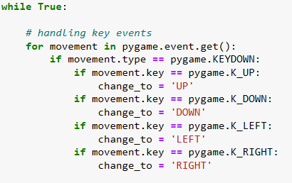
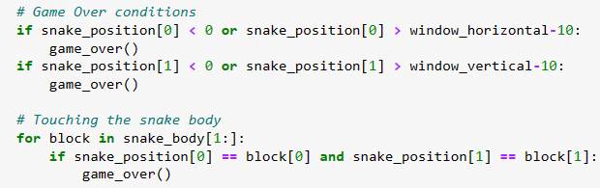
Implementation
Examples:
Snake movement
Game over

Slide 6
Challenges and Solution
There were functions I did not fully understand.
There is many ties so when I changed one function, I had to change several others.
I did lots of research to understand the code.
Methodically go through each line changing what is needed.

Slide 7
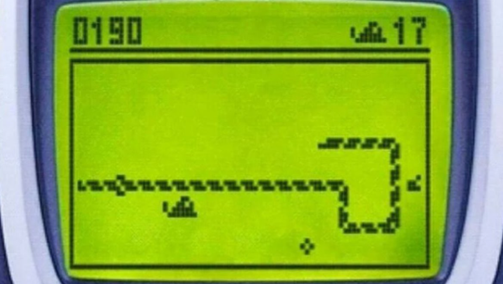
User Experience
The user is the one moving the snake
Feedback:
Add superpowers.
Personalize the snake
Option for snake speed

Slide 8
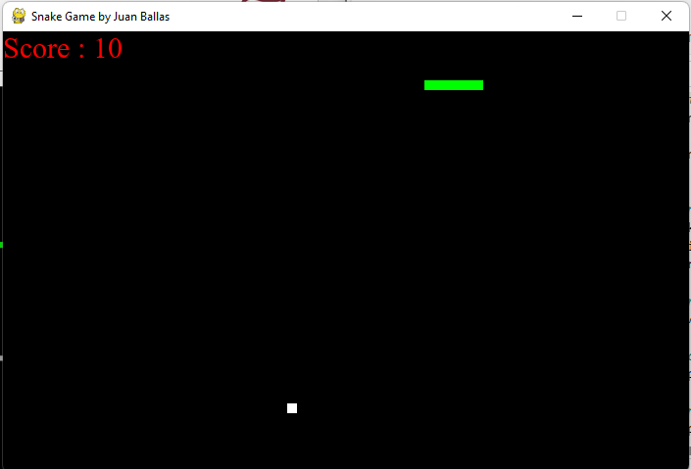
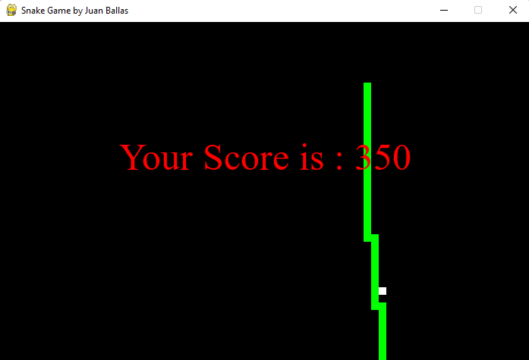
Demonstration
Link

Slide 9
Lessons Learned
How useful the functions we learnt can be
How accessible python is for us
Import pygame and time
Decisions made differently?
I would have chosen something business related

Slide 10
Conclusion
Python uses are unlimited
Make all type of games
What we learnt in this class is very useful
You can stay fresh with fun codes

Slide 11
THE END

